Slide 1
Sangre de Cristos Amateur Radio Club
Packet Radio Comms Session II
Installing Winlink to work with Radio for Radio Mail Service (RMS)

Slide 2
Objectives

Slide 3
Objectives
Download, install & configure Winlink Client Software and supporting modem software
Configure Hardware
  Radio
  Computer
  Terminal Network Controller
Compose an E-mail message & send through your radio to a local Winlink mail server / Gateway

Slide 4
Recommended Equipment For this Session
Radio without built in sound card nor TNC
  VHF and/or UHF mobile or base station
    Use of handheld transceivers is possible but not recommended to start with
  Computer
    Windows 10 or later operating system
      With at least 3 USB ports
  Sound card
    TigerTronics SignalinkTM USB
  Cables
    USB Cable from computer to SignaLinkTM sound card
      Provided in the with the SignaLinkTM sound card
    Cable from the sound card to the radio
Radio with built in sound card / TNC
  VHF and/or UHF mobile or base station
    Use of handheld transceivers is possible but not recommended to start with
  Computer
    Windows 10 or later operating system
      With at least 3 USB ports
  Cables
    Need the correct cable that goes from the computer USB port to the RADIO’s TNC or data port

Slide 5
Review:
Where is the Terminal Node Controller located?
There are multiple configurations of a combination of hardware & software that make up TNC functionality
  Sometimes it’s built into the radio ( such as the Yaesu FT-991A)
  Sometimes it’s totally contained within an electronics box inserted between a personal computer and a radio
  Sometimes various functions of the TNC is split between software on a personal computer and a sound card.

Slide 6
Review:
Where is the Terminal Node Controller located?
Let’s focus on this configuration
There are multiple configurations of a combination of hardware & software that make up TNC functionality
  Sometimes it’s built into the radio ( such as the Yaesu FT-991A)
  Sometimes it’s totally contained within an electronics box inserted between a personal computer and a radio
  Sometimes various functions of the TNC is split between software on a personal computer and a sound card.

Slide 7
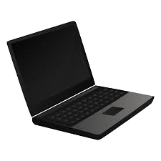
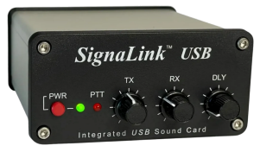
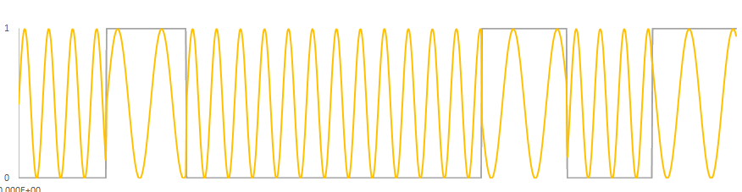
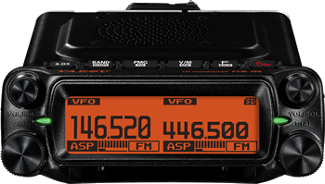
Third Configuration - TNC split between software on PC and a soundcard
Distributed TNC Function
010000101

Slide 8
Software Download & Install

Slide 9
Software
Two Software application to install are:
  Soundmodem
    Converts digital data to binary frequencies for use on “Packet Radio”
  Winlink Express
    User Interface software
      with e-mail creation, radio connection, message send & receive

Slide 10
Download & Install
SoundModem

Slide 11
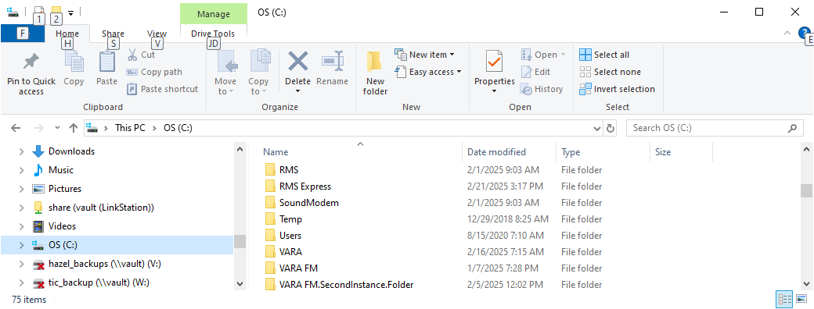
Soundmodem - Download & Install
Go to the (C:) folder aka “root folder” and create a new folder and change its name to SoundModem

Slide 12
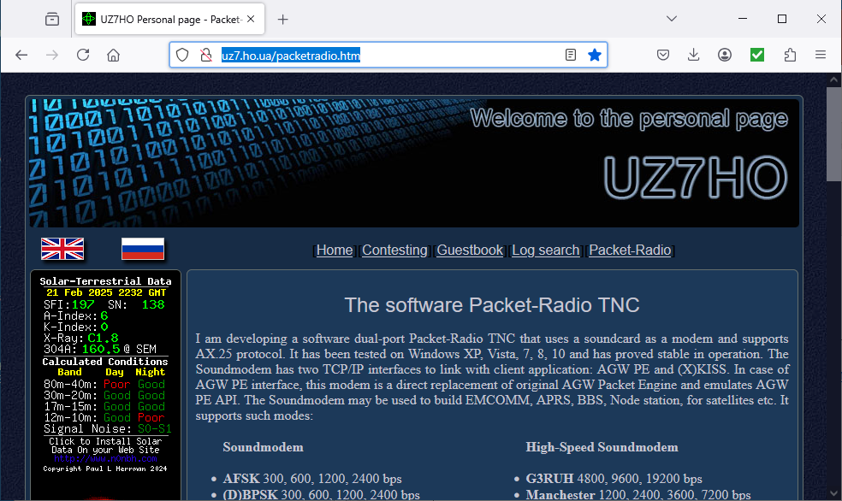
Soundmodem
Download & Install
  Go to webpage → http://uz7.ho.ua/packetradio.htm

Slide 13
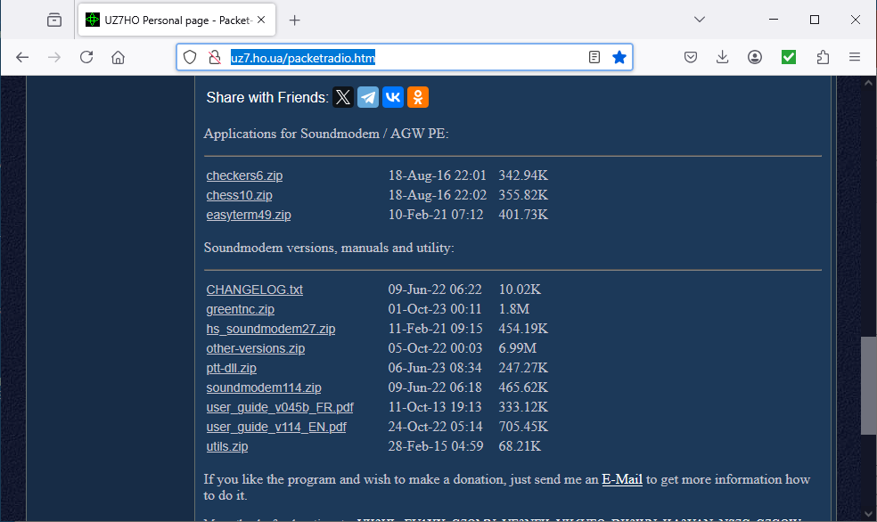
Soundmodem
Download & Install
Scroll down until you see the link labeled soundmodem114.zip or similar (“114” is the version number and may change) and click on it in order to download

Slide 14
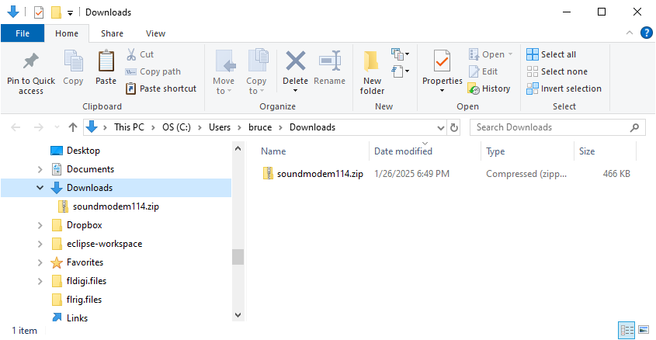
Sound Modem
Download & Install
Find the soundmodemxxx.zip file by navigating to your Downloads Folder

Slide 15
A word about .zip folders
A folder with .zip suffix is a compressed file or collection of files and the contents must be decompressed and extracted in order to use.
This process is referred to as extracting or unzipping
To unzip (extract) on Windows 7 or later systems
  Locate the zipped folder that you want to unzip (extract) files or folders from.
  Do one of the following:
    To unzip a single file or folder, double click on the zipped folder in order to open it and see the contents, then drag the file or folder from the zipped folder to a new location.
    or
    To unzip all the contents of the zipped folder, press and hold (or right-click) the folder, select Extract All..., and then follow the instructions.

Slide 16
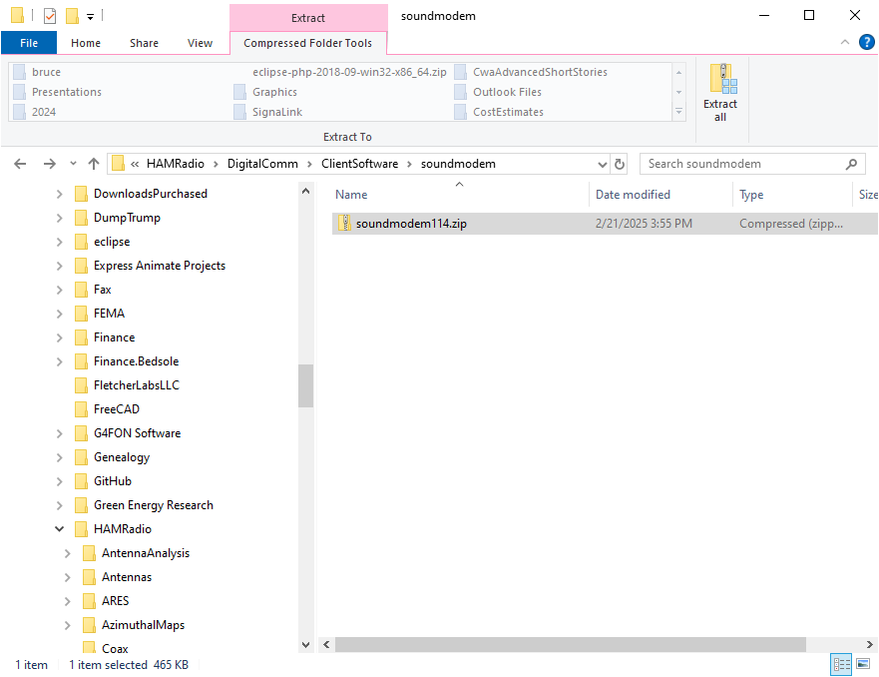
How to Extract All
Select the .zip file then…
Click on “Extract All”

Slide 17
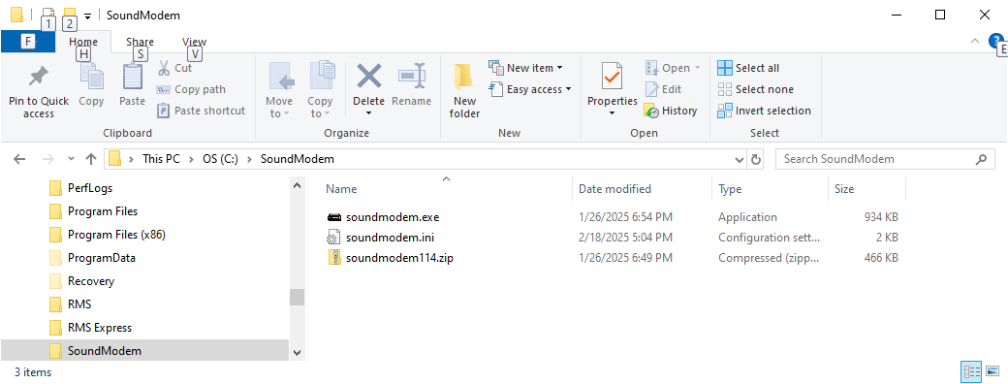
Soundmodem
Download & Install
    Move the soundmodem114.zip file from the Downloads file to the C:\SoundModem folder.
    Extract the .zip file into the C:\SoundModem folder.

Slide 18
Download & Install Winlink Express

Slide 19
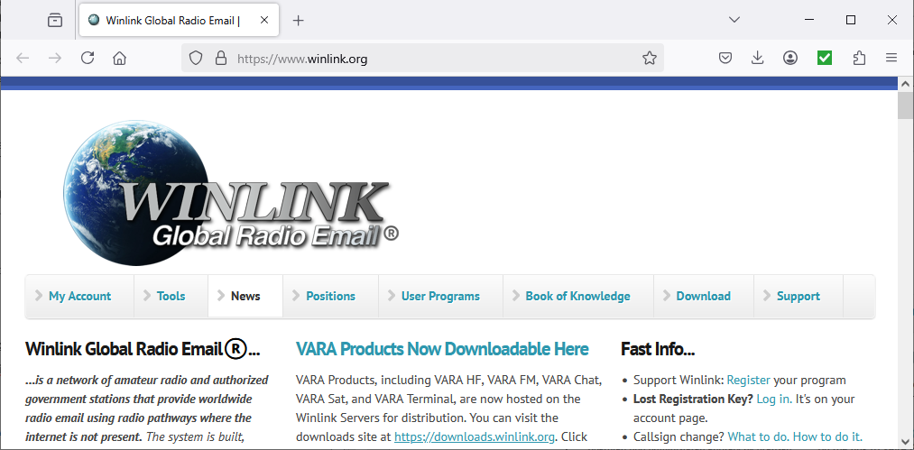
RMS Express (aka Winlink, aka Winlink Express)
Download & Install
  Go to website → https://www.winlink.org/ and click on “Download”

Slide 20
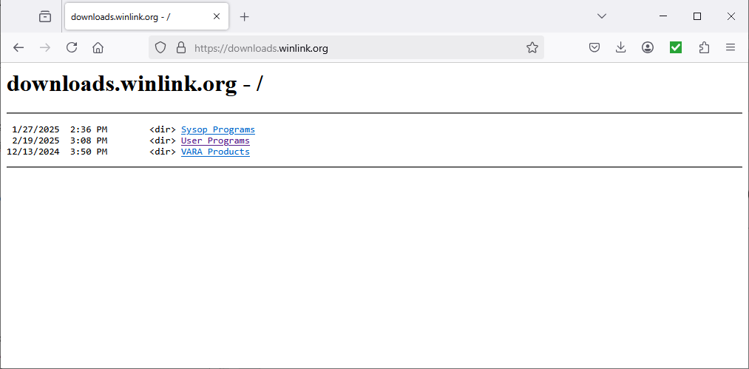
RMS Express (aka Winlink, aka Winlink Express)
Download & Install
Click on “User Program”

Slide 21
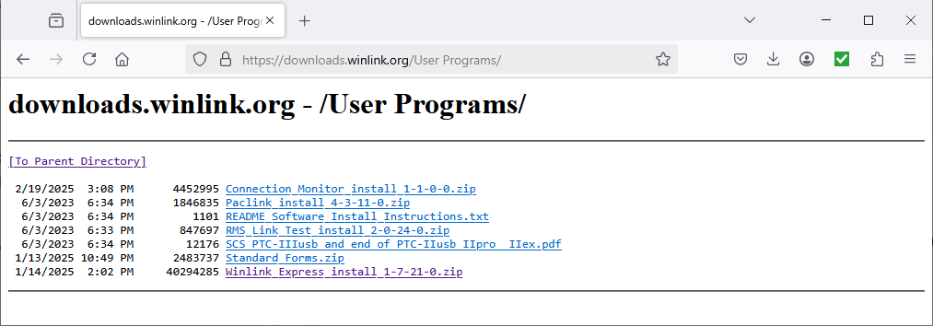
RMS Express (aka Winlink, aka Winlink Express)
Download & Install
Click on “Winlink_Express_install_1-7-21-0.zip”

Slide 22
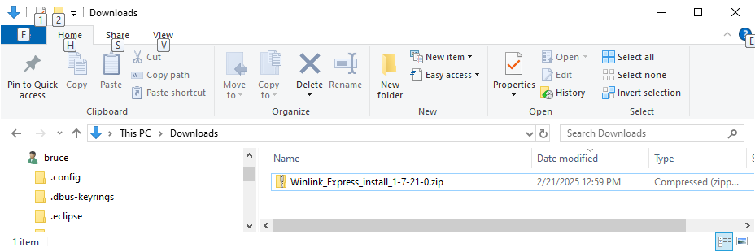
RMS Express (aka Winlink, aka Winlink Express)
Download & Install
Go to Downloads folder and extract the contents of the .zip file

Slide 23
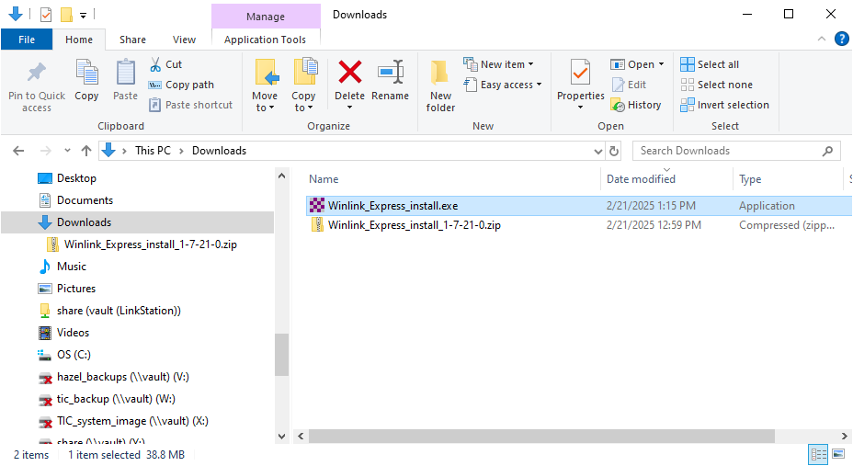
RMS Express (aka Winlink, aka Winlink Express)
Download & Install
Click on “Winlink_Express_install.exe”

Slide 24
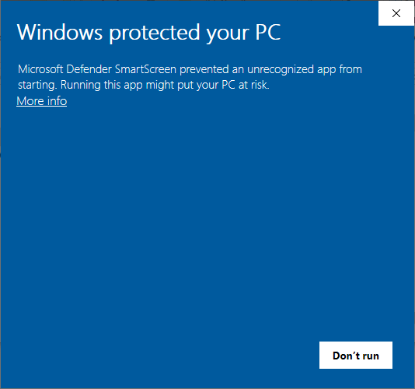
RMS Express (aka Winlink, aka Winlink Express)
Download & Install
This is a false warning. Click “More_info”

Slide 25
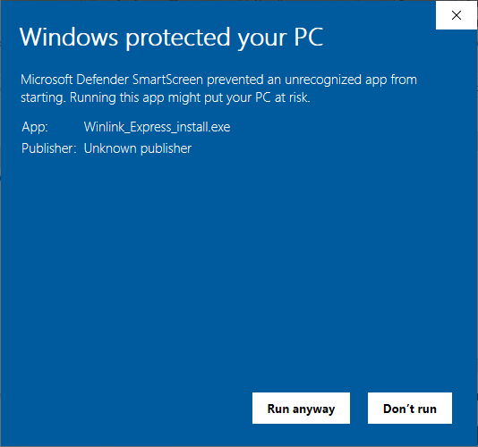
RMS Express (aka Winlink, aka Winlink Express)
Download & Install
Click “Run anyway”

Slide 26
Now let’s Connect Computer, SignaLink Sound Card & Radio
Different for every computer

Slide 27
Before connecting SignaLink to your computer
Let’s Open the Device manager……….

Slide 28
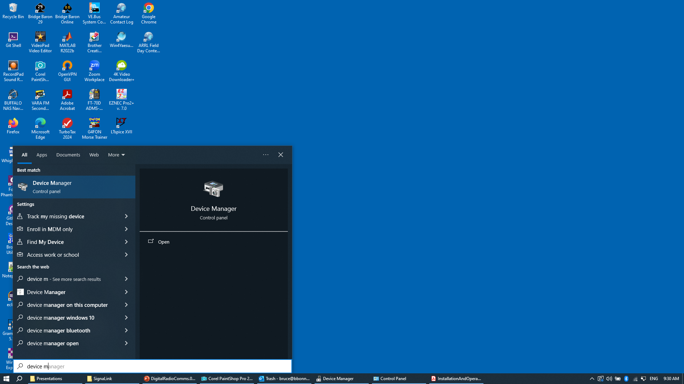
Opening Device Manager
Second,
Click on “Device manager”
First,
Press the Windows Key and type “Device Manager”

Slide 29
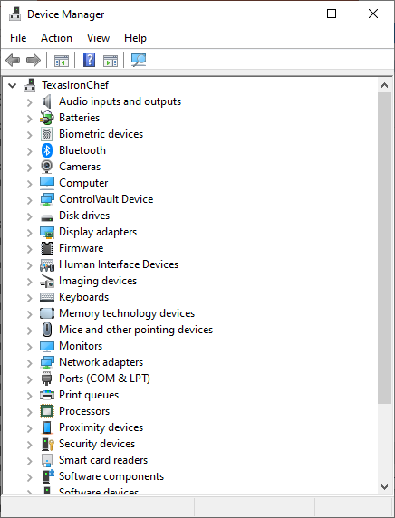
Device Manager
Look for “Audio inputs and outputs” in Device Manager and double click on it to expand

Slide 30
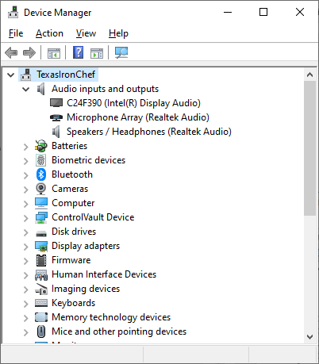
Device Manager
Note Audio Devices

Slide 31
Connect SignaLink to Computer
Plug in the Signal Link USB cable in between the SignaLink and the computer and turn on

Slide 32
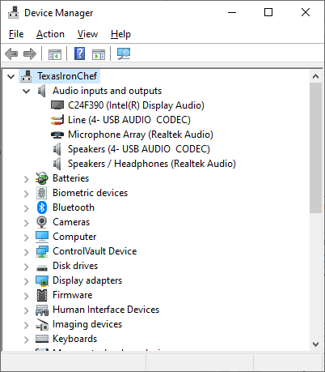
New Audio Devices appear in Device Manager
Before Plugin
After Plugin
Notice the
New Audio Devices here on the right

Slide 33
Restore Windows System default Audio Devices

Slide 34
Windows Automatic USB Device Detection/Selection
When a new USB audio device is plugged into a Window Operating System based computer, (as we just did) the Windows Operating System assumes the user wants to use that audio device as the system default audio device.
This is an incorrect action on part of the operating system when a modem sound card such as SignaLink USB is attached.
  So, the default audio devices must be restored for normal computer operations and so that the radio will not transmit normal computer sounds

Slide 35
Restore System default audio devices (continued)
Using the Windows Operating System Sound Control Panel

Slide 36
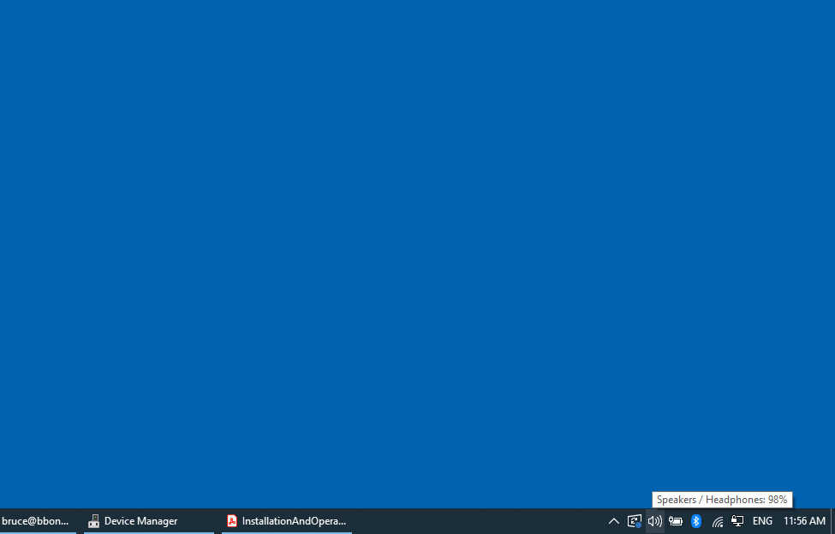
Open Sound Control
Go to lower right hand corner of desktop

Slide 37
Sound Control
Right Click on Speaker Icon

Slide 38

Sound Control
Select Sounds

Slide 39
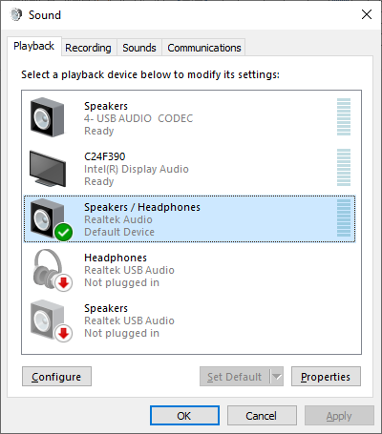
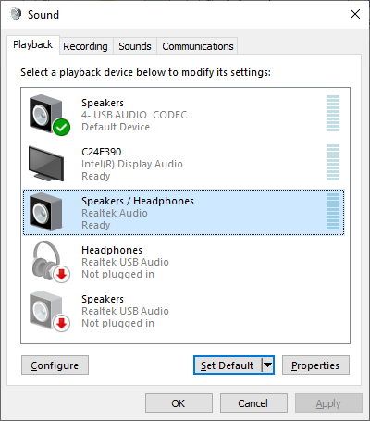
Restore System default audio Playback device
Highlight your normal audio output Devices & click on
“Set Default”

Slide 40
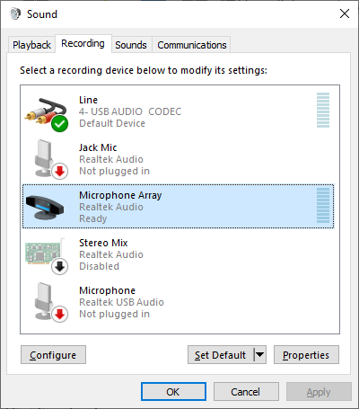
Restore System default audio Recording device
Highlight normal microphone input device & click on
“Set Default”

Slide 41
Adjust SignaLink Audio Levels
For radio operation

Slide 42
Adjusting Receive Volume on SignaLink Soundcard
Reopen the Sound Control Panel go to Recording tab
Double Click what ever audio device the SignaLink soundcard is for your computer

Slide 43
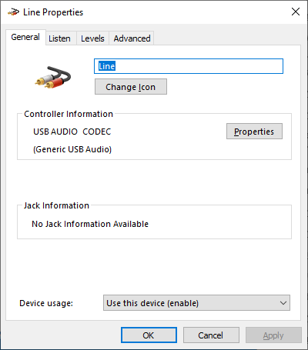
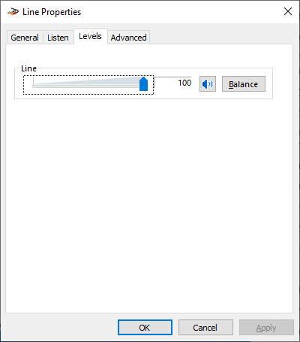
Note to Bruce: Add recording level adjust slide
Select “Levels” tab
Slid Line volume to 100

Slide 44
Winlink Express Software
Launch & Configure

Slide 45

Start Winlink Express
Find either the
  Winlink Express icon
    or the
  RMS Express icon
on your computer Desktop screen and double click it

Slide 46
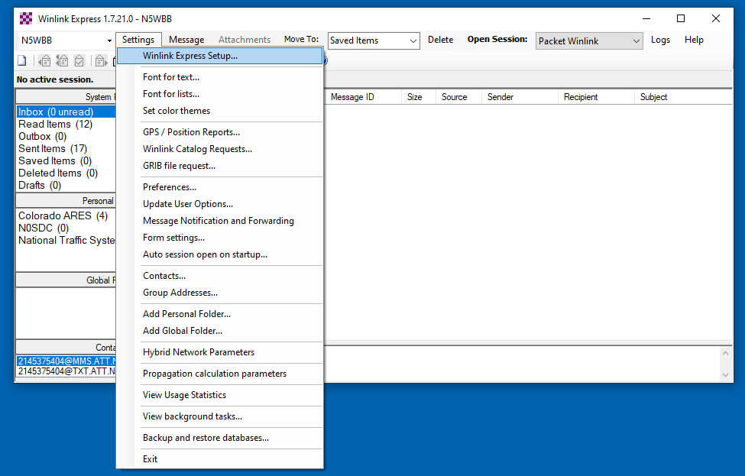
Configure Winlink Express
Under the Setting tab, select Winlink Express Setup

Slide 47
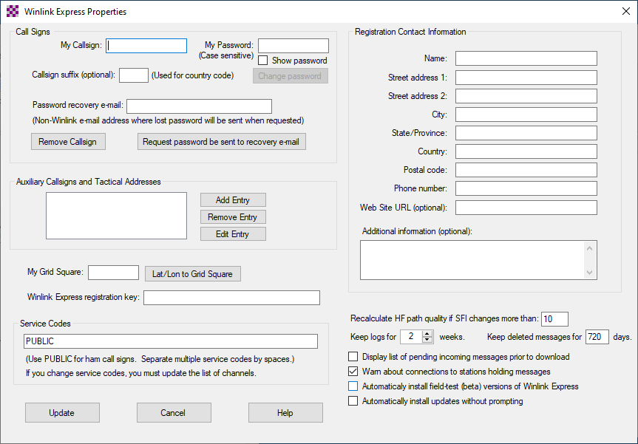
Configure Winlink Express
  Fill out the Winlink Express Properties page with you callsign, address and grid square location etc….
  Create a password and remember it. ☺
  When finished click update

Slide 48
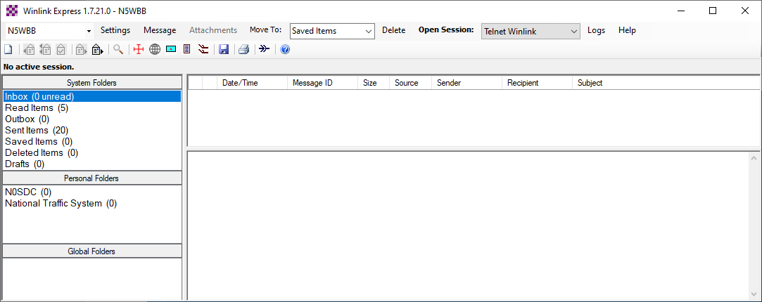
Configure Winlink Express
  Click on the dropdown list to the right of “Open Session:” and select “Packet Winlink”

Slide 49

Configure Winlink Express
  Click on “Open Session:”

Slide 50
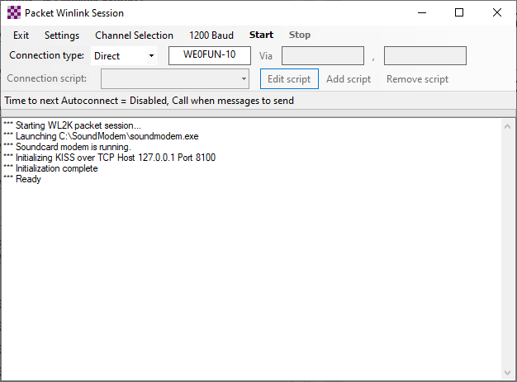
Configure Winlink Express
Click on Settings

Slide 51
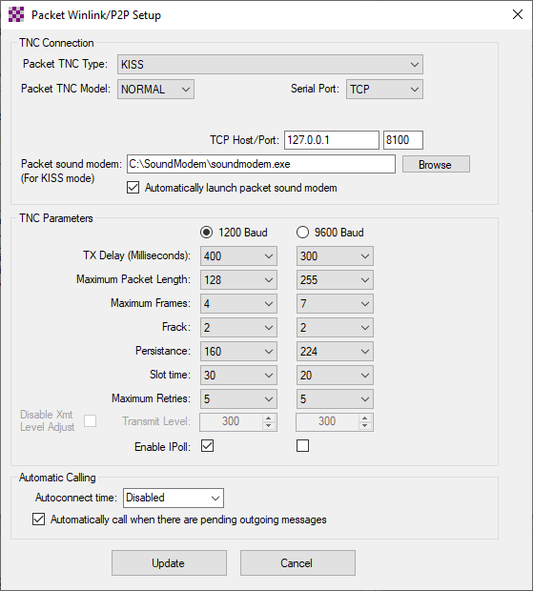
Packet Settings
Packet TNC Type: KISS
Packet TNC Model: NORMAL
Serial Port: TCP
TCP Host/Port: 127.0.0.1 8100
Packet Sound Modem (browse to SoundModem’s
folder location)
Automatically launch packet sound modem CHECK
TNC Parameters check 1200 Baud
Enable Ipoll CHECK
Automatically call when there are pending outping messages CHECK
Click on “Update” to close

Slide 52
Restart Winlink Express
Close the Packet Winlink Session Window
Exit Winlink Express
Re-start Windows Express
At the top of Winlink program window, re-select a “Packet Winlink” session to the right of “Open Session:”
Click on “Open Session”

Slide 53
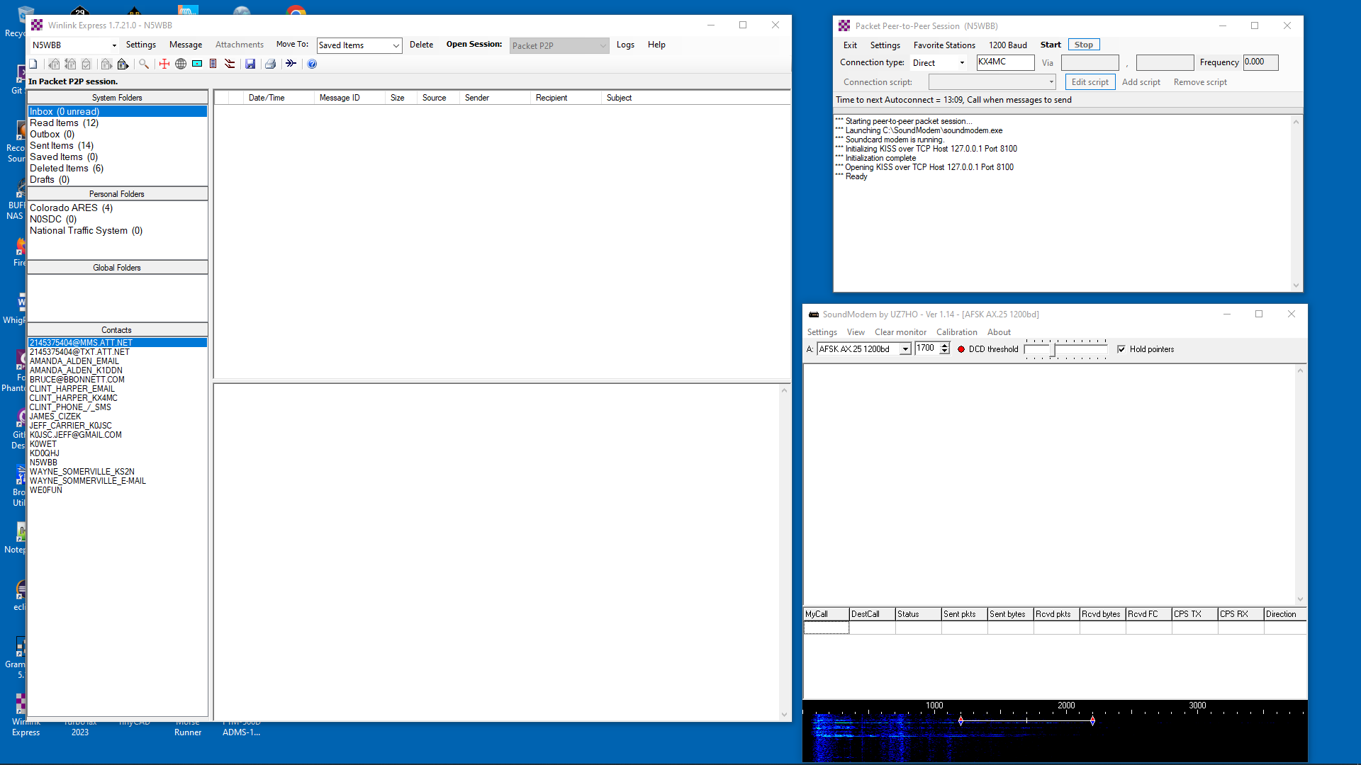
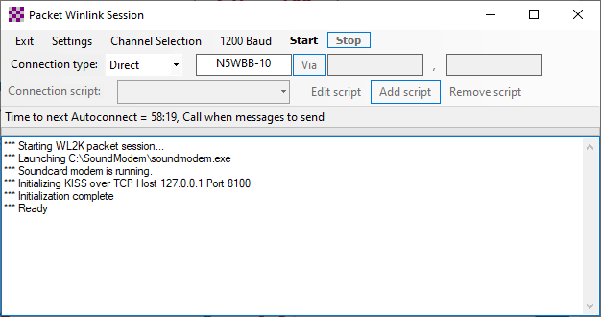
Look for 3 Windows:
The Winlink window,
The Packet Winlink Session window,
& the SoundModem window
Packet
Session
Winlink
soundmodem

Slide 54
Configure SoundModem
Select SignaLink as soundmodem audio devices

Slide 55
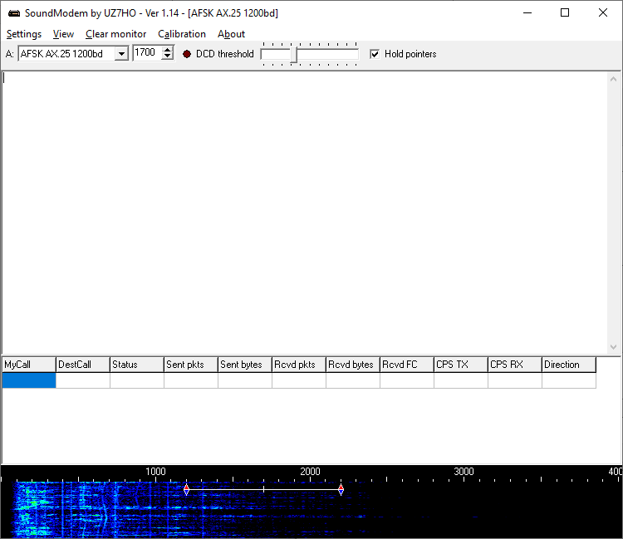
Configure SoundModem

Slide 56
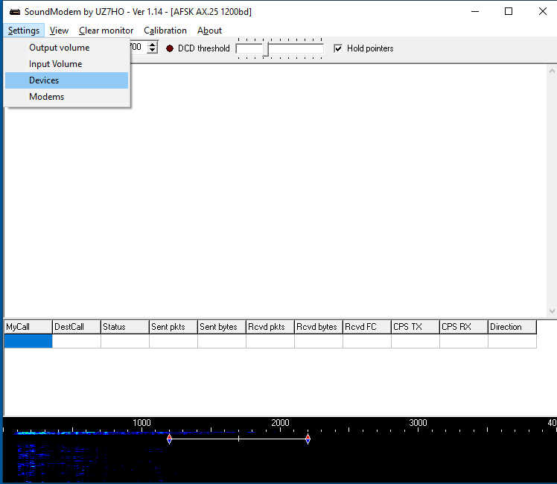
Select Audio Devices
Under Settings select “Devices”

Slide 57
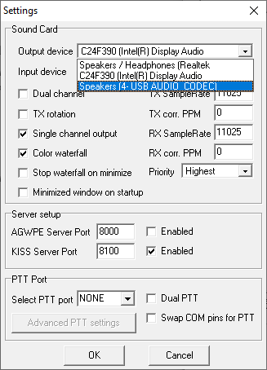
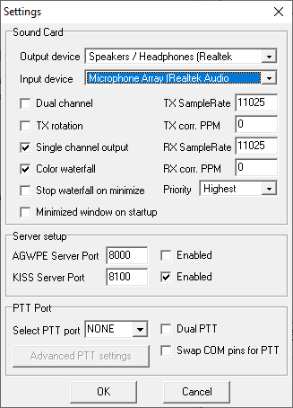
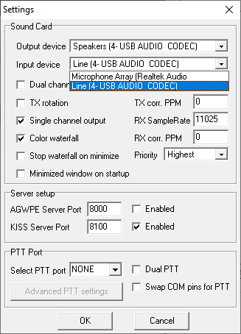
Select Audio Devices

Slide 58
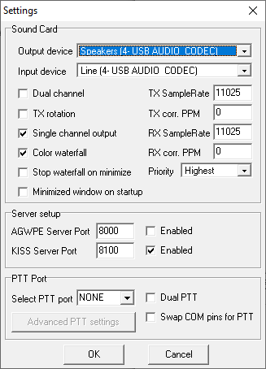
Other Device Settings
Uncheck TX rotation
Check Single channel output
Check Color waterfall
AGWPE Server Port Uncheck Enabled
KISS Server Port 8100 & check Enabled
Select PTT Port NONE
Uncheck Dual PTT
Uncheck Swap COM pin
Click OK

Slide 59
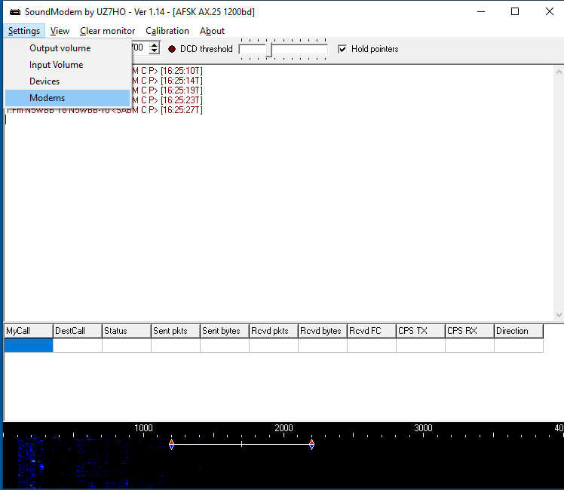
Modem Timing Settings
Under settings click “Modems”

Slide 60
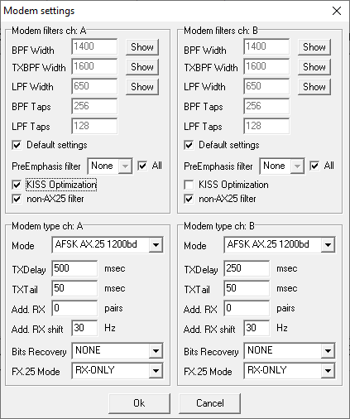
Soundmodem Modem Settings
Check KISS Optimization
Check non-AX25 filter
Under Modem type ch: A
Mode AFSK AX.25 1200bd
TXDelay 500 msec
Click on “OK”

Slide 61
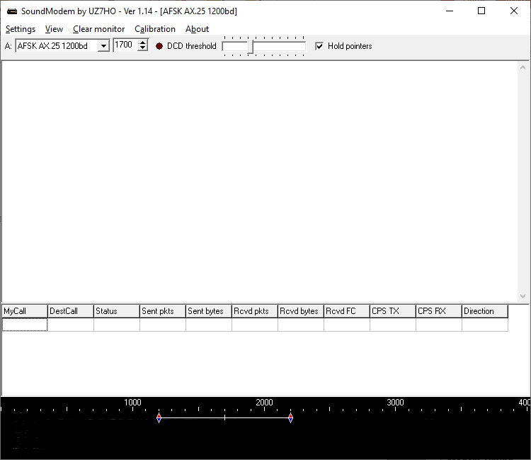
SoundModem Main Window Settings
Select AFSK AX.25 1200bd
Check Hold pointers

Slide 62
Sending an Email Message

Slide 63
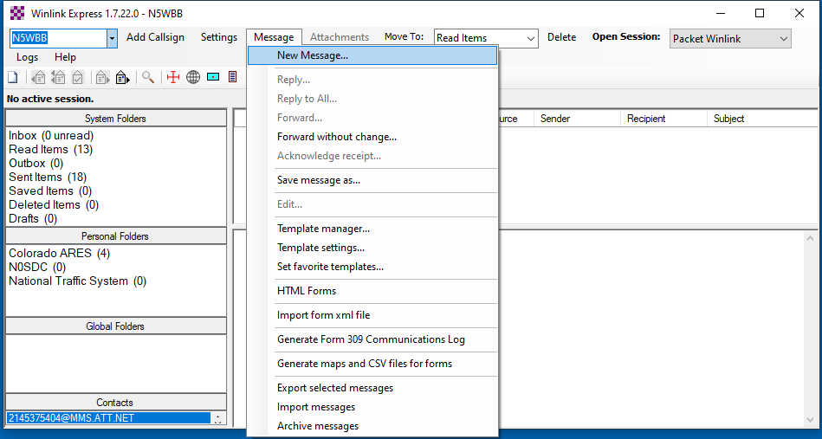
Compose an E-mail message
Under Message Menu select New Message….

Slide 64
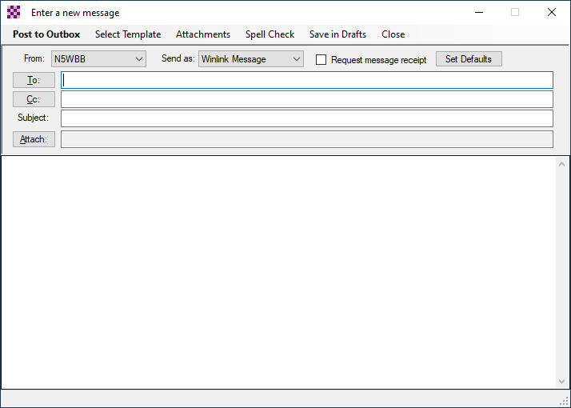
Composing E-mail message
Select “Winlink Message”
Enter either Call Sign or an e-mail address
Area for typing message

Slide 65
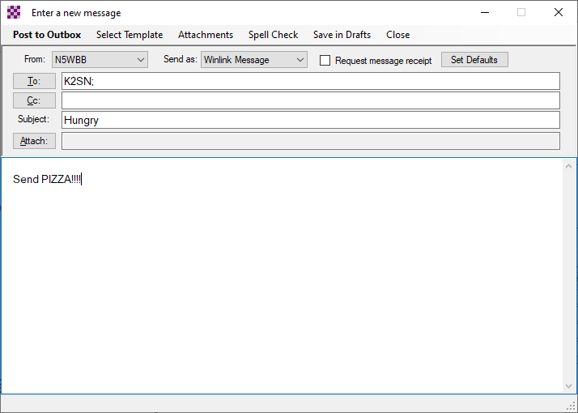
Post Message
After message is composed, click on
“Post to Outbox”

Slide 66
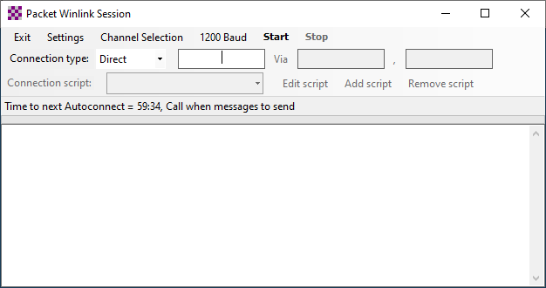
Select Gateway
Click on Channel Selection

Slide 67
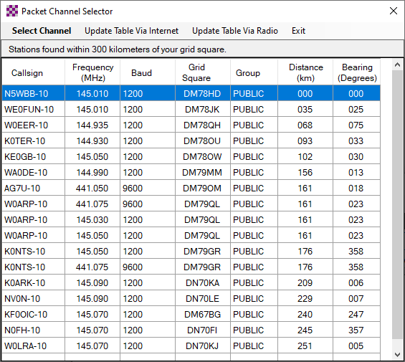
Select Gateway
Select closest Gateway

Slide 68
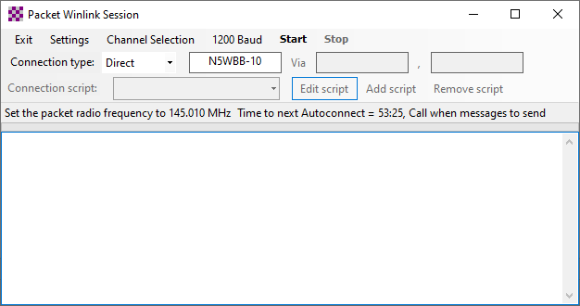
Set your Radio Frequency
Set your Radio Frequency to the Gateway’s Frequency

Slide 69
Send E-mail
Click “Start”

Slide 70
Winlink Client Sends Message
If not sent, then….. we’ll start debugging ☺

Slide 72
BACKUP SLIDES
backup

Slide 73
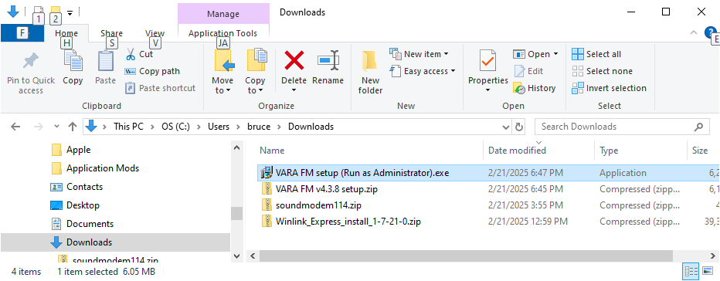
VARA FM (optional)
    Go to webpage → https://downloads.winlink.org/VARA%20Products/
    Download the file VARA%20FM%20v4.3.8%20setup.zip
    Extract and run the installation VARA%20FM%20setup%20 (Run%20as%20Administrator).exe similar to method used to install RMS winlink

