Slide 1
Packet Radio Communications

Slide 2
Objective
Understand how a Packet communications station works,
Understand how to set-up a Packet communications station,
Understand how to operate it
BUILD ONE!!!!!

Slide 3
Two Session Talk
First Session – Digital Transmission & Reception Concepts
Second Session - Hands-on Set-up your own radio

Slide 4
Talk Outline
Concepts Session
Overview of Packet Radio Communications
Terms:
Digital
Packet
BIT
BYTE
BAUD
TNC
MODEM
Overview of Packet Radio Relaying
How digital communications are sent over Amateur Radio Frequencies
Radio Messaging System
Preview of required equipment and software required to perform digital communications in the VHF (2 Meter) & UHF (70 cm) Ham Radio Bands
Demonstrate Software installation & configuration
Hands-on Workshop
Install Software
Connect computer to radio through supporting equipment
Send Mail

Slide 5
Packet Radio Communications
What is it?
For us, it’s a method of sending and receiving email messages, chat texts, even photos & documents over your radio to another radio or for retrieval via the internet.

Slide 6
Let’s back up a bit ….
What is “DIGITAL”
In the context of both computers & digital communications, digital means data expressed as series of 0’s and 1’s called ….
BINARY numbers
What are and Why use Binary numbers?
Binary numbers easily represent something that is either ON or OFF
Examples
A Light bulb
An ON/OFF switch
A single transistor in an electronic circuit
They can also easily represent something that has two states or conditions
Morse Code -> DOT or DASH
Audio tone -> A LOW / HIGH pitch audio Tone
This is where we are headed

Slide 7
Light Bulb Example
Let’s assign 1 and 0 to the light bulb state
Light bulb ON = 1
Light bulb OFF = 0
Tah Dah!!!! Voila!! A binary system in your living room

Slide 8
A bit more binary
Now let’s say we have 3 light bulbs
And agree that
Bulb 1 has a weight of 1 when ON, but 0 when OFF
Bulb 2 has a weight of 2 when ON, but 0 when OFF
Bulb 3 has a weight of 4 when ON, but 0 when OFF
Bulb 3 | Bulb 2 | Bulb 1 | Binary Number | Decimal Number
OFF | OFF | OFF | 0 0 0 | 0
OFF | OFF | ON | 0 0 1 | 1
OFF | ON | OFF | 0 1 0 | 2
OFF | OFF | OFF | 0 1 1 | 3
ON | OFF | OFF | 1 0 0 | 4
ON | OFF | ON | 1 0 1 | 5
ON | ON | OFF | 1 1 0 | 6
ON | ON | ON | 1 1 1 | 7

Slide 9
Binary Representation
Example of 1’s & 0’s representation
By convention (fancy word for agreement)
The letter ‘A’ is represented by decimal number 65 and binary number 01000001
The letter ‘B’ is represented by decimal number 66 and binary number 01000010
The letter ‘C’ is represented by decimal number 67 and binary number 01000011
The letter ‘D’ is represented by decimal number 68 and binary number 01000100
The letter ‘E’ is represented by decimal number 69 and binary number 01000101
There is a representation for every character on your keyboard

Slide 10
ASCII TABLE
Character | Digital Representation | Character | Digital Representation | Character | Digital Representation
Space | 0100000 | @ | 01000000 | ` | 01100000
! | 0100001 | A | 01000001 | a | 01100001
" | 0100010 | B | 01000010 | b | 01100010
# | 0100011 | C | 01000011 | c | 01100011
$ | 0100100 | D | 01000100 | d | 01100100
% | 0100101 | E | 01000101 | e | 01100101
& | 0100110 | F | 01000110 | f | 01100110
' | 0100111 | G | 01000111 | g | 01100111
( | 0101000 | H | 01001000 | h | 01101000
) | 0101001 | I | 01001001 | i | 01101001
* | 0101010 | J | 01001010 | j | 01101010
+ | 0101011 | K | 01001011 | k | 01101011
, | 0101100 | L | 01001100 | l | 01101100
- | 0101101 | M | 01001101 | m | 01101101
. | 0101110 | N | 01001110 | n | 01101110
/ | 0101111 | O | 01001111 | o | 01101111
0 | 0110000 | P | 01010000 | p | 01110000
1 | 0110001 | Q | 01010001 | q | 01110001
2 | 0110010 | R | 01010010 | r | 01110010
3 | 0110011 | S | 01010011 | s | 01110011
4 | 0110100 | T | 01010100 | t | 01110100
5 | 0110101 | U | 01010101 | u | 01110101
6 | 0110110 | V | 01010110 | v | 01110110
7 | 0110111 | W | 01010111 | w | 01110111
8 | 0111000 | X | 01011000 | x | 01111000
9 | 0111001 | Y | 01011001 | y | 01111001
: | 0111010 | Z | 01011010 | z | 01111010
; | 0111011 | [ | 01011011 | { | 01111011
< | 0111100 | ] | 01011100 | | | 01111100
= | 0111101 | \ | 01011101 | } | 01111101
> | 0111110 | ^ | 01011110 | ~ | 01111110
? | 0111111 | _ | 01011111 | delete | 01111111
American Standard Code
for
Information Interchange
ASCII for short

Slide 11
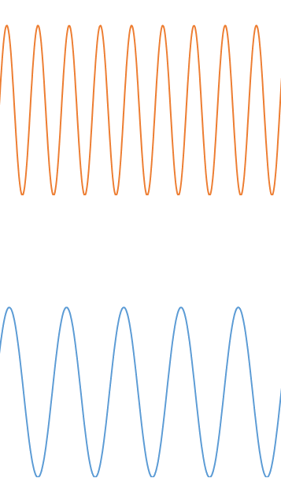
Digital Communications
Transmitting 1’s & 0’s over ham radio frequencies
Convert 1’s & 0’s to audio
Assign a unique tone to 0 & 1
0 = 2200 Hz tone
1 = 1200 Hz tone

Slide 12
Play Live Audio Tones

Slide 13
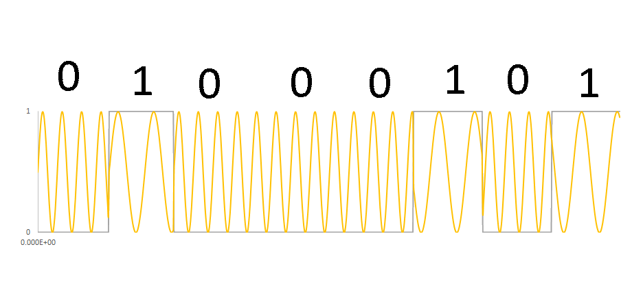
Tone Encode the character ‘E’

Slide 14
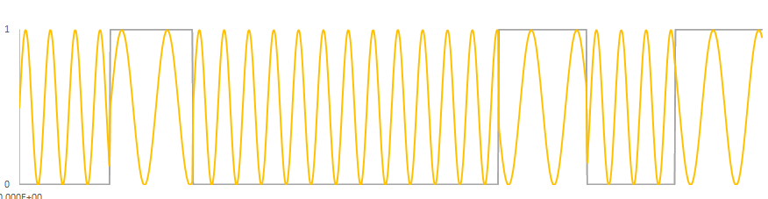
Tone Encode & Decode
Sound
Card
Sound
Card

Slide 15
Let’s digress for a moment
To talk about BITS & BYTES

Slide 16
Bits and Bytes
A Single Digit is a ‘bit’
0 1 0 0 0 0 1 0 1
8 bits make a ‘byte’

Slide 17
Bit Rate and BAUD
6.66666 milliseconds
Transmission Speed is expressed in bit/second

Slide 18
Let’s take a break

Slide 19
Back to Tone Encode & Decode

Slide 20
Terminal Node Controller
TNC for short

Slide 21
Terminal Node Controller
A TNC takes raw digital data such as characters in an e-mail message
divides the characters in an e-mail message into small segments,
converts the character to binary 8 bit bytes
adds some extra bits of information (no pun intended) to provide an error checking / detecting / correcting scheme, and puts those into “packets” data
then converts those packets, bit by bit, into audio tones

Slide 22
Details on Data packing

Slide 23
Details on Data packing
This is a topic for a later day for anybody that is interested

Slide 24
Where is the Terminal Node Controller located?
There are multiple configurations of a combination of hardware & software that make up TNC functionality
Sometimes it’s built into the radio ( such as the Yaesu FT-991A)
Sometimes it’s totally contained within an electronics box inserted between a personal computer and a radio
Sometimes various functions of the TNC is split between software on a personal computer and a sound card.

Slide 25
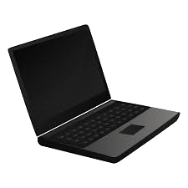
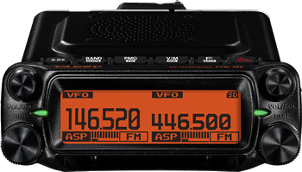

Terminal Node Controller in the radio
E
E
010000101
010000101

Slide 26
Terminal Node Controller in a Box
E
010000101
010000101
E
TNC
TNC

Slide 27
A Terminal Node Controller TNC that is split between software on a personal computer and a sound card.
E
010000101
010000101
E
Sound
Card
Sound
Card

Slide 28
Hardware Example with specific products for
the third configuration where the TNC functionality is split between software on a personal computer and a sound card.

Slide 29
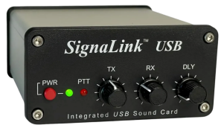
Example Client Hardware Set up
010000101

Slide 30
Radio Networking Architectures

Slide 31
Radio Mail Networking Architectures
Peer To Peer
Mail Server
Gateway
Telnet

Slide 32
Peer to Peer Topology
Sound Card
E
010000101
010000101
E
Sound
Card
Sound Card
Message Server

Slide 33
Peer To Peer Limitations
Advantages
Simplest architecture
Limitations
Can only send an email to one station at a time
Both station operators are required to be operating their stations at the same time in order to send a message

Slide 34
Radio Mail Server Architecture
Local
Radio Mail Server
Mail is sent to the Local Radio Mail Server and stored until it is picked up by destination address
Ability to send one message to multiple stations
TNC
TNC
TNC
TNC
TNC
Linda
Clint
Ken
Bruce

Slide 35
Gateway Expanded Radio Mail Server Network

Slide 36


Extended Radio Mail Service
Message Gateway
CMS
Message Gateway
TNC
TNC
TNC
TNC
TNC
TNC
TNC
TNC
Linda
Clint
Ken
Bruce

Slide 37
Telnet Architecture
CMS

Slide 38
Next Session Preview

Slide 39
Next Session Preview
Hands-on Workshop
Install Software
Connect computer to radio through supporting equipment
Learn how to use Software
Send and Receive Mail
This is where we’re headed

Slide 40
Recommended Equipment For Next Session
Radio without built in sound card nor TNC
VHF and/or UHF mobile or base station
Use of handheld transceivers is possible but not recommended to start with
Computer
Windows 10 or later operating system
With at least 3 USB ports
Sound card
TigerTronics SignalinkTM USB
https://tigertronics.shop/shop/ols/categories/signalink-usb
Cables
USB Cable from computer to SignaLinkTM sound card
Provided in the with the SignaLinkTM sound card
Cable from the sound card to the radio
This cable type & make is dependent on the radio
TigerTronics has a list of cables for popular radios in the .pdf file called “SignaLink USB Product Guide”
Note to Bruce: Print out Product Guide
Web link is : https://tigertronics.com/files/SignaLink%20USB%20Product%20Guide.pdf
Radio with built in sound card / TNC
VHF and/or UHF mobile or base station
Use of handheld transceivers is possible but not recommended to start with
Computer
Windows 10 or later operating system
With at least 3 USB ports
Cables
Need the correct cable that goes from the computer USB port to the RADIO’s TNC or data port

Slide 41
Let’s take a look at the Signalink website
It’s made by a company called Tigertronics
https://tigertronics.com/
And Download the product selector guide
https://tigertronics.com/files/SignaLink%20USB%20Product%20Guide.pdf
And then let’s shop
https://tigertronics.shop/

Slide 42
Questions

Slide 43
Session 2

Slide 44
Installing Winlink to work with Radio for RMS (Radio Mail Service)

Slide 45
Review: Where is the Terminal Node Controller located?
There are multiple configurations of a combination of hardware & software that make up TNC functionality
Sometimes it’s built into the radio ( such as the Yaesu FT-991A)
Sometimes it’s totally contained within an electronics box inserted between a personal computer and a radio
Sometimes various functions of the TNC is split between software on a personal computer and a sound card.

Slide 46
Let’s focus on…
the third configuration where the TNC functionality is split between software on a personal computer and a sound card.

Slide 47
Example Client Hardware Set up
Distributed TNC Function
010000101

Slide 48
Ordering Signalink USB sound card with correct cables

Slide 49
Connect Signalink USB sound card

Slide 50
Software
Soundmodem
Converts digital data to binary frequencies for use on “Packet Radio”
RMS Express (aka Winlink, aka Winlink Express)
User Interface software
with e-mail creation, radio connection, message send & receive
VARA FM (optional)
Converts digital data to binary frequencies for use on “VARA Packet Radio”

Slide 51
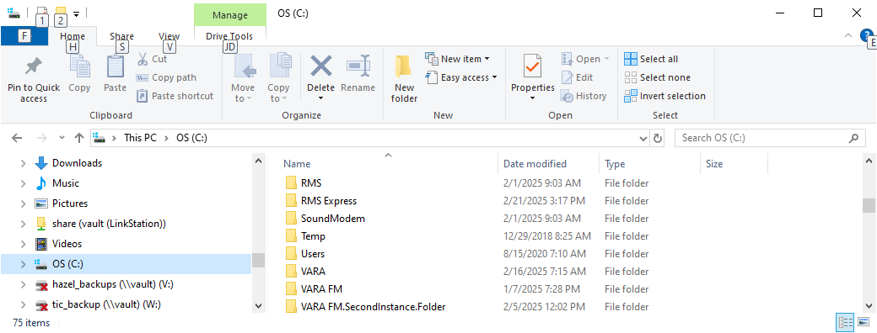
Soundmodem Download & Install
Go to the (C:) folder aka “root folder” and create a new folder and change its name to SoundModem

Slide 52
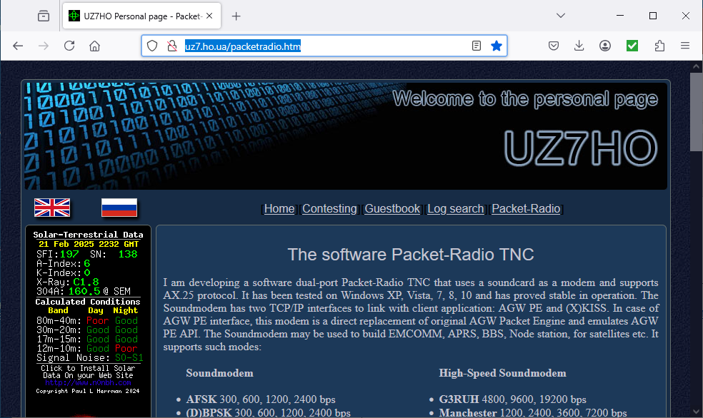
Soundmodem Download & Install
Go to webpage → http://uz7.ho.ua/packetradio.htm

Slide 53
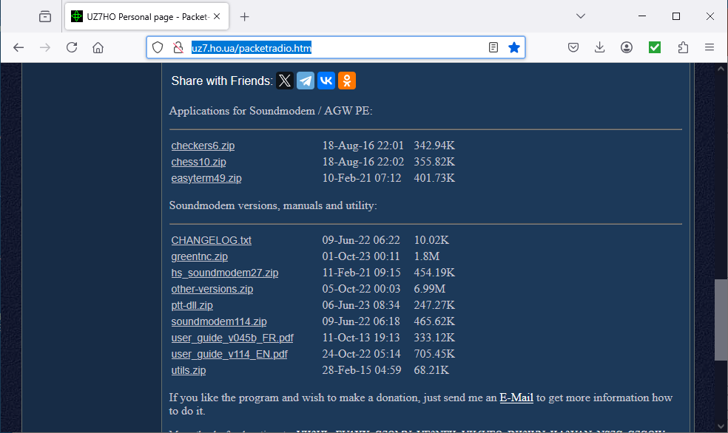
Soundmodem Download & Install
Scroll down until you see the link labeled soundmodem114.zip or similar (“114” is the version number and may change) and click on it

Slide 54
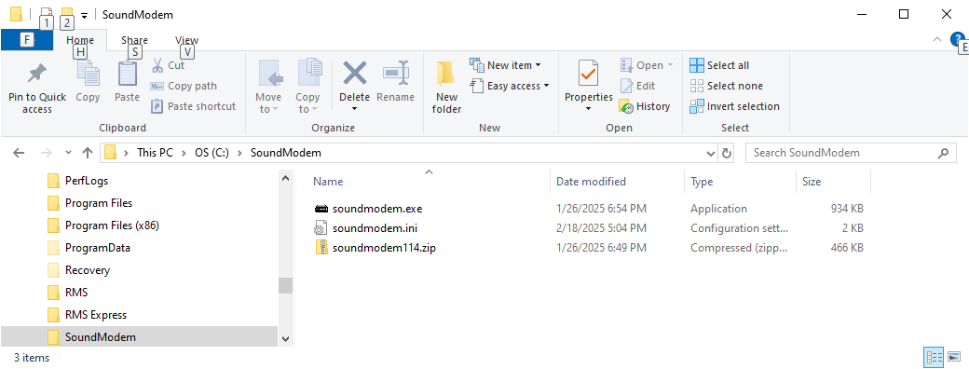
Soundmodem Download & Install
Move the soundmodem114.zip file from the Downloads file to the C:\SoundModem folder.
Extract the .zip file into the C:\SoundModem folder.

Slide 55
Connect Computer, SignaLink Sound Card & Radio
Different for every computer

Slide 56
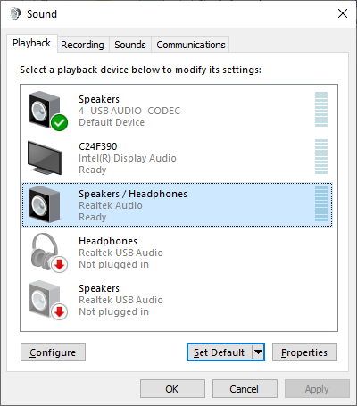
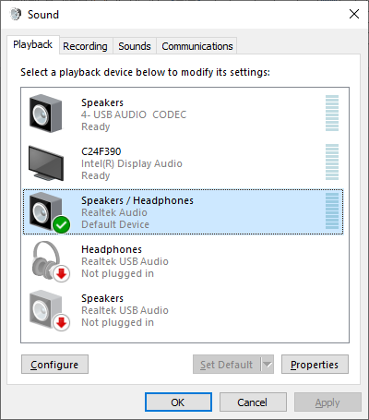
Adjust Audio Playback & Recording Devices

Slide 57
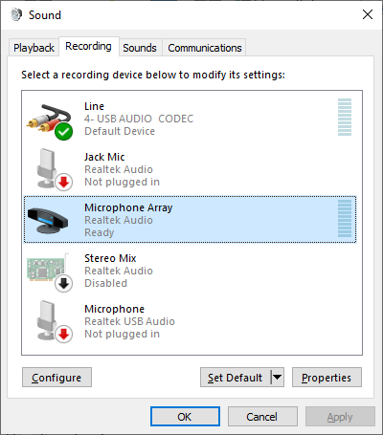
Adjust Audio Playback & Recording Devices
Open the Sound Control Panel

Slide 58
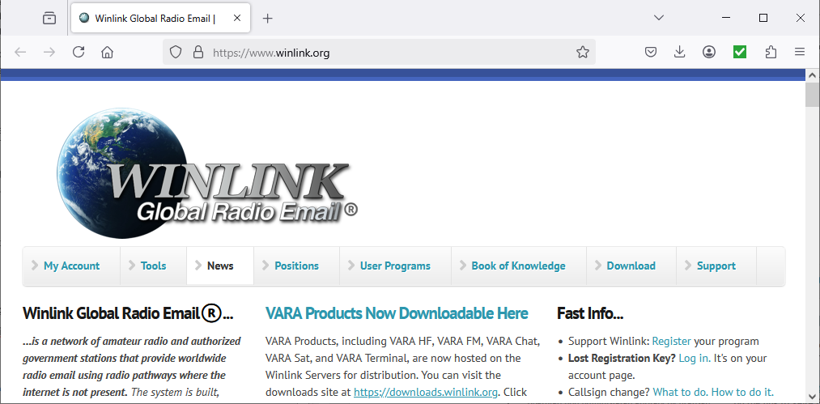
RMS Express (aka Winlink, aka Winlink Express) Download & Install
Go to website → https://www.winlink.org/ and click on “Download”

Slide 59
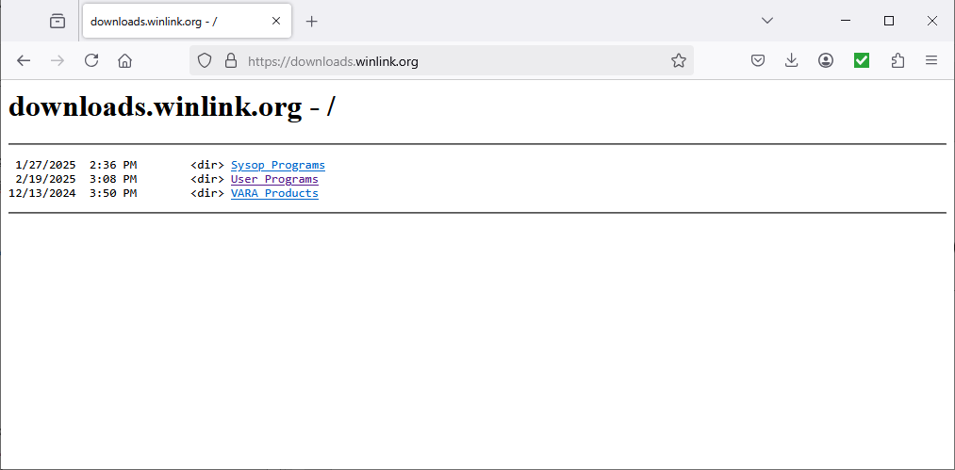
RMS Express (aka Winlink, aka Winlink Express) Download & Install
Click on “User Program”

Slide 60
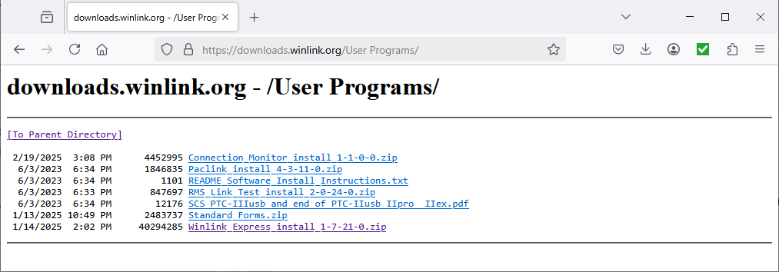
RMS Express (aka Winlink, aka Winlink Express) Download & Install
Click on “Winlink_Express_install_1-7-21-0.zip”

Slide 61
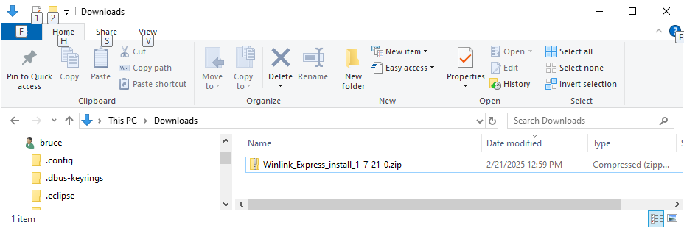
RMS Express (aka Winlink, aka Winlink Express) Download & Install
Go to Downloads folder and extract the contents of the .zip file

Slide 62
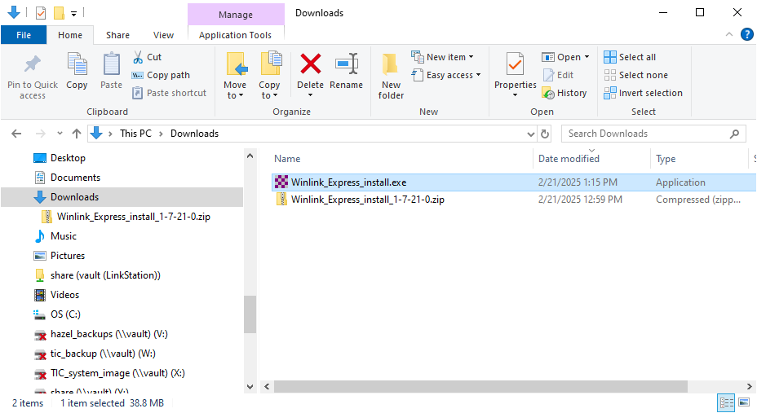
RMS Express (aka Winlink, aka Winlink Express) Download & Install
Click on “Winlink_Express_install.exe”

Slide 63
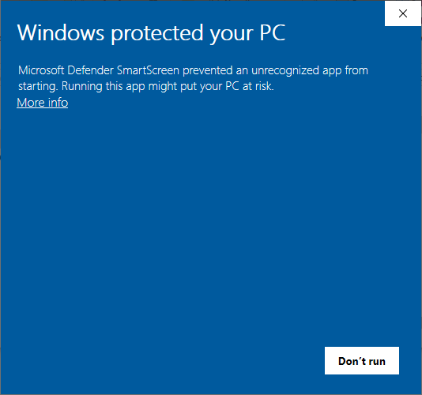
RMS Express (aka Winlink, aka Winlink Express) Download & Install
This is a false warning. Click “More_info”

Slide 64
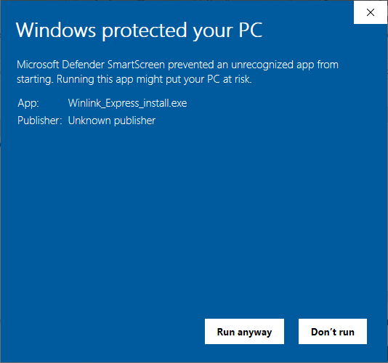
RMS Express (aka Winlink, aka Winlink Express) Download & Install
Click “Run anyway”

Slide 65
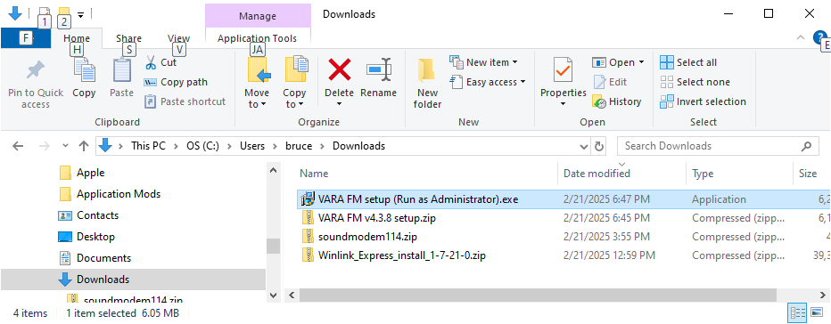
VARA FM (optional)
Go to webpage → https://downloads.winlink.org/VARA%20Products/
Download the file VARA%20FM%20v4.3.8%20setup.zip
Extract and run the installation VARA%20FM%20setup%20 (Run%20as%20Administrator).exe similar to method used to install RMS winlink

Slide 66
Run and configure RMS Express (aka Winlink, aka Winlink Express)
After installation is complete, find either the
Winlink Express icon
or the
RMS Express icon
on your computer Desktop screen and double click it

Slide 67

Here’s mine

Slide 68
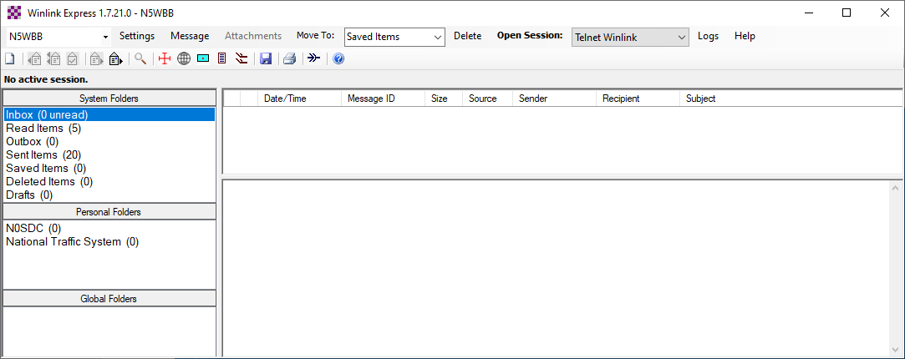
Configure Winlink Express
Under the Setting tab, select Winlink Express Setup….

Slide 69
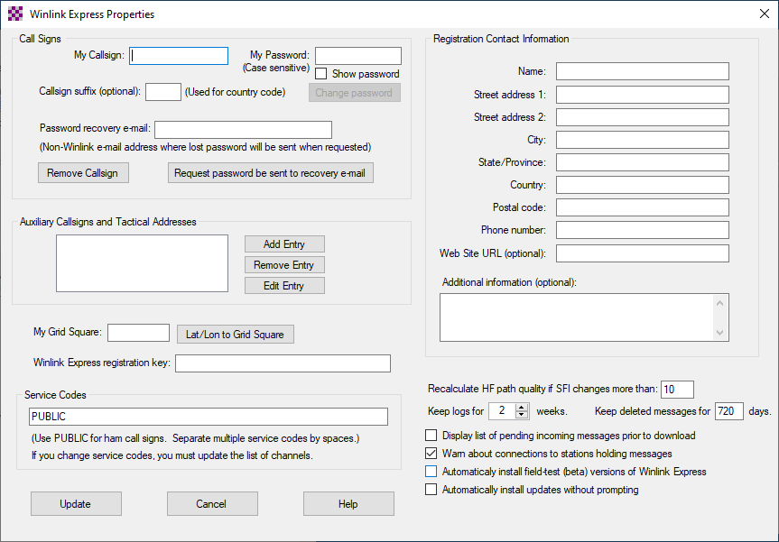
Configure Winlink Express
Fill out the Winlink Express Properties page with you callsign, address and grid square location etc….
When finished click update

Slide 70
Configure Winlink Express
Click on the drop down list to the right of “Open Session:” and select “Packet Winlink”

Slide 71

Configure Winlink Express
Click on “Open Session:”

Slide 72
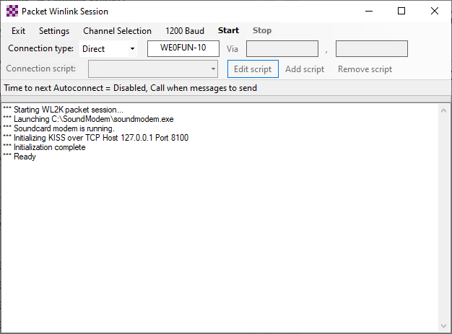
Configure Winlink Express
Click on Settings

Slide 73
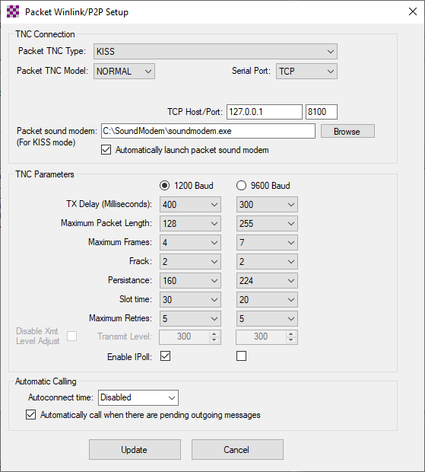
Packet Setup
Change settings to match what is shown here

Slide 74
BACKUP SLIDES
Technical and whys

Slide 75
Packet Radio Communications

Slide 76
A word about Packet radio relay
Winlink
The CMS station

Slide 77
Digression about what is a TNC

Slide 78
What does a Terminal Node Controller Do?
A Terminal Node Controller
converts text characters into a series of 1’s & 0’s
Then converts the 1’s & 0’s into audio tones for transmission over the radio.
Example
1’s & 0’s representation
Letter A is represented by the series 01000001
Letter B is represented by the series 01000010
Letter C is represented by the series 01000011
Convert 1’s & 0’s to audio
0 = 2200 Hz tone
1 = 1200 Hz tone

Slide 79
My Dig Comm station with Distributed TNC
Uses…
Hardware
A TH 7800 2 meter radio made by TYT
A Signalink USB sound card from Tigertronics
A personal Computer with the following software:
Software
Winlink Express ( aka RMS express)
A program called “soundmodem”
All the above software is free

Slide 80
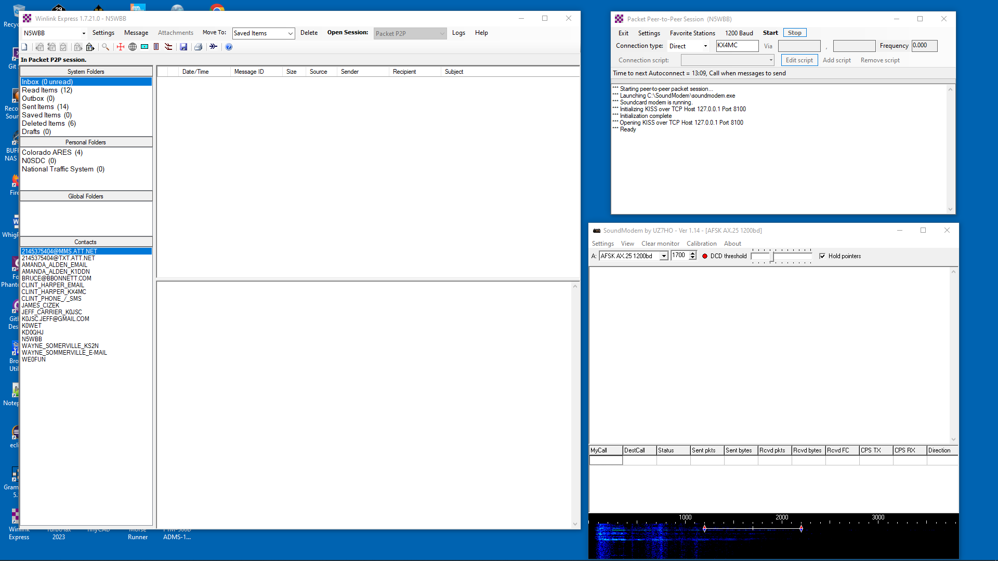
Winlink -> Peer to Peer Session - > soundmodem
Peer to Peer
Session
Winlink
soundmodem

Slide 81
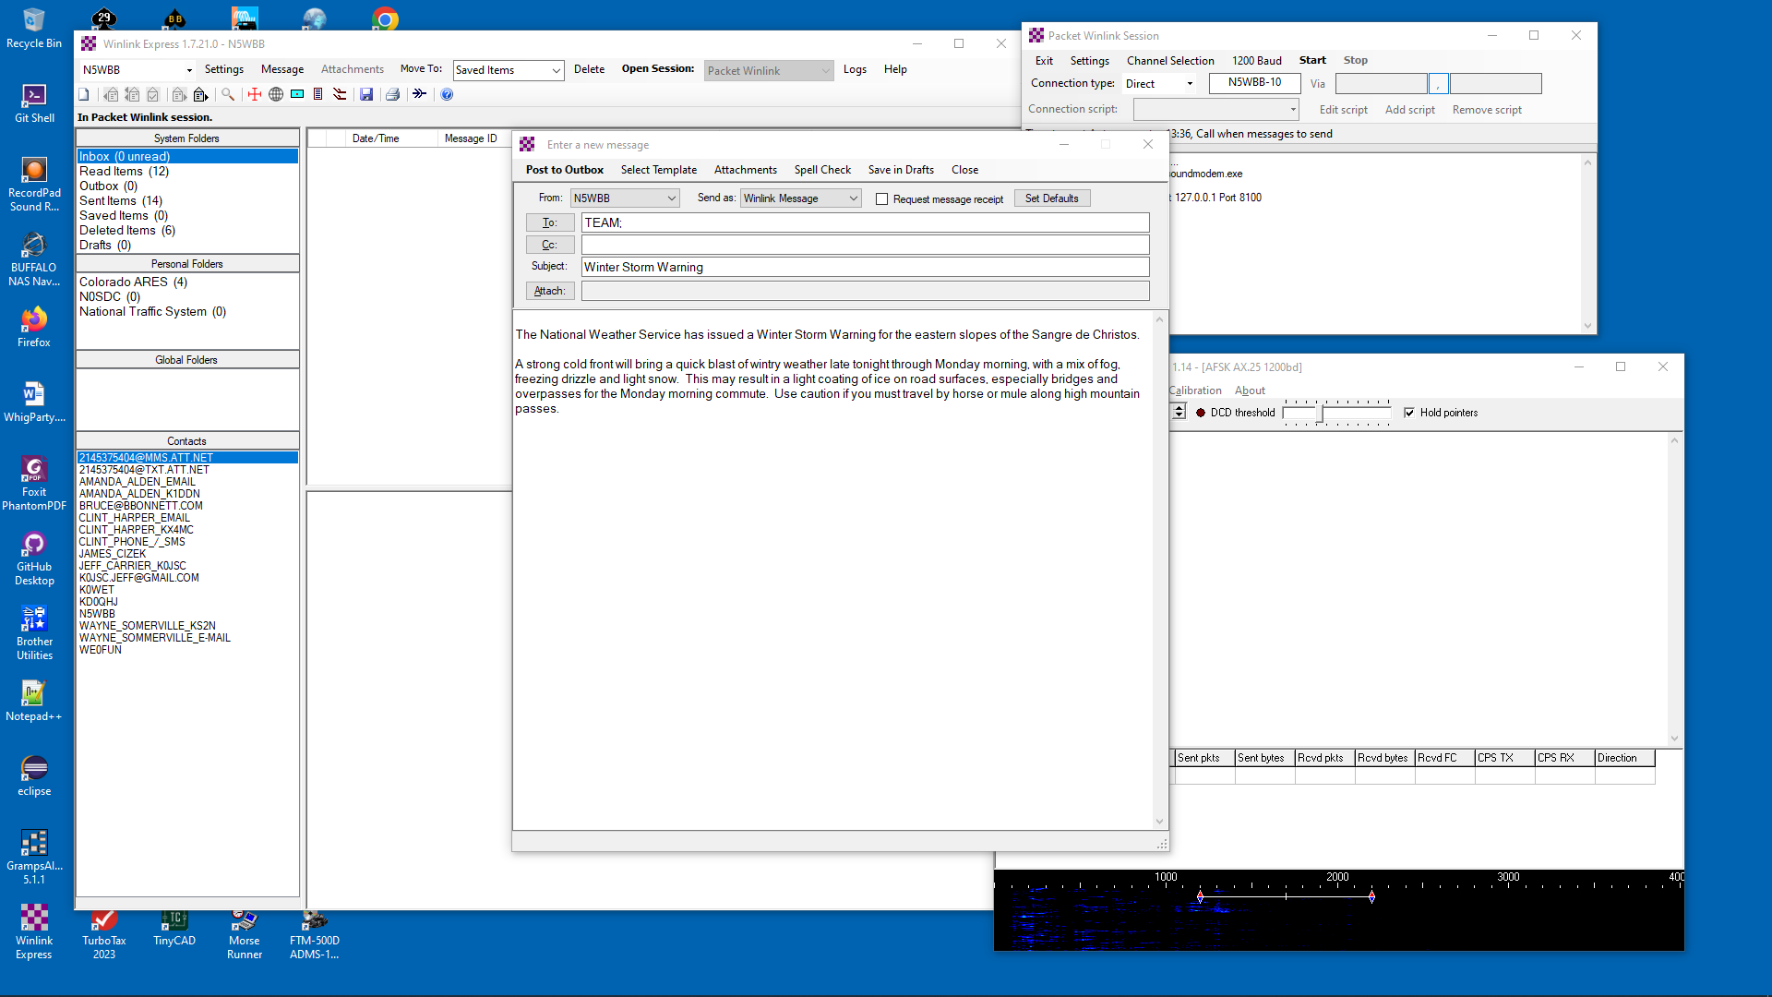
Compose an Email

